Slide 1

SQL Project: RCB - IPL Strategy

Slide 2

PROBLEM STATEMENT
You are hired as a sports data analyst by RCB where the team is looking for top-performing and reliable players to win tournaments, considering both on-field performance and value for money in mega player auction of 2017.
Your task is to come up with strategies/suggestions regarding selecting the best-performing players and optimizing player auction investments.

Slide 3
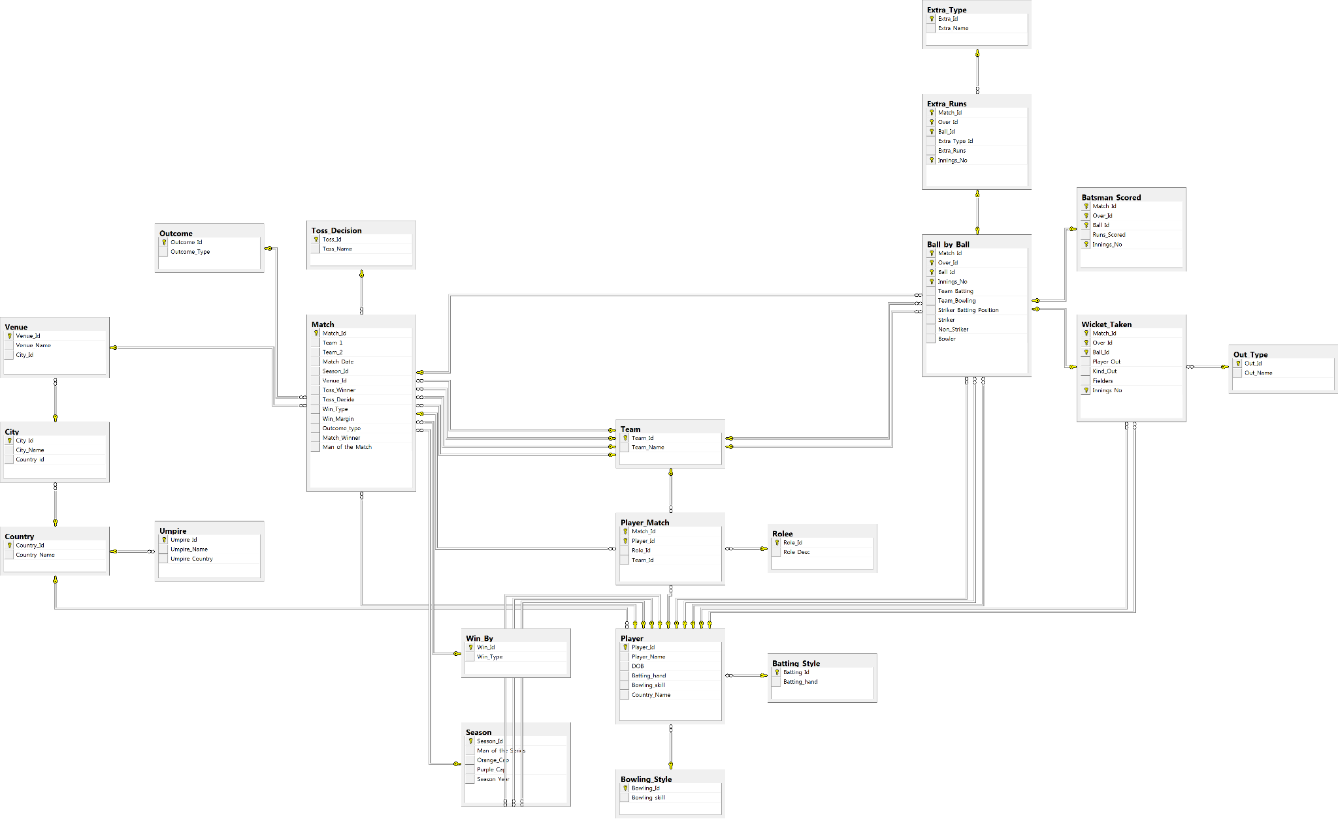
DATABASE SCHEMA

Slide 4

DATA DESCRIPTION
Ball by Ball
Match_id: Unique identifier for a cricket match
Over_id: Unique identifier for an over in a cricket match
Ball_id: Unique identifier for a ball in an over
Innings_No: The innings number in a cricket match
Team_Batting: The team batting in a particular innings
Team_Bowling: The team bowling in a particular innings
Striker_Batting_Position: The batting position of the striker batsman
Striker: The batsman currently on strike
Non_Striker: The batsman currently at the non-striker's end
Bowler: The bowler bowling the current delivery
Batsman Scored
Match_Id: Unique identifier for the match.
Over_Id: Identifier of the over.
Ball_Id: Identifier of the delivery.
Runs_Scored: Runs scored by the batsman from the delivery.
Innings_No: Identifies the innings.
Extra Runs
Match_Id: Unique identifier for the match.
Over_Id: Identifier of the over.
Ball_Id: Identifier of the delivery.
Extra_Type_Id: Identifier representing the type of extra.
Extra_Runs: Number of extra runs scored on the delivery.
Innings_No: Identifies the innings.

Slide 5
DATA DESCRIPTION
Wicket Taken
Match_Id: Unique identifier for the match.
Over_Id: Identifier of the over.
Ball_Id: Identifier of the delivery.
Player_Out: Identifier of the dismissed player.
Kind_Out: Identifier representing the dismissal type.
Fielders: Identifier of the fielder involved, where applicable.
Innings_No: Identifies the innings.
Player
Player_Id: Unique identifier assigned to each player.
Player_Name: Name of the player.
DOB: Date of birth of the player.
Batting_hand: Identifier representing the player's batting hand.
Bowling_skill: Identifier representing the player's bowling skill.
Country_Name: Identifier representing the player's country.
Player Match
Match_Id: Unique identifier for the match.
Player_Id: Unique identifier for the player.
Role_Id: Identifier representing the player's role.
Team_Id: Identifier of the team represented by the player.
Team
Team_Id: Unique identifier for a team.
Team_Name: Name of the IPL team.
Batting Style
Batting_Id: Unique identifier for a batting style.
Batting_hand: Describes the batting hand/style.
Bowling Style
Bowling_Id: Unique identifier for a bowling style.
Bowling_skill: Describes the bowling skill or type.

Slide 6
DATA DESCRIPTION
Role
Role_Id: Unique identifier for a player role.
Role_Desc: Description of the player's role.
Country
Country_Id: Unique identifier for a country.
Country_Name: Name of the country.
Season
Season_Id: Unique identifier for an IPL season.
Man_of_the_Series: Identifier of the Man of the Series.
Orange_Cap: Identifier of the Orange Cap winner.
Purple_Cap: Identifier of the Purple Cap winner.
Season_Year: Year of the season.
Venue
Venue_Id: Unique identifier for a venue.
Venue_Name: Name of the cricket stadium or venue.
City_Id: Identifier of the city where the venue is located.
Matches
Match_Id: Unique identifier for the match.
Team_1: Identifier of the first team.
Team_2: Identifier of the second team.
Match_Date: Date of the match.
Season_Id: Identifier of the season.
Venue_Id: Identifier of the venue.
Toss_Winner: Identifier of the team that won the toss.
Toss_Decide: Identifier of the toss decision.
Win_Type: Identifier representing the type of victory.
Win_Margin: Margin of victory.
Outcome_type: Identifier representing the match outcome.
Match_Winner: Identifier of the winning team.
Man_of_the_Match: Identifier of the Man of the Match.
City
City_Id: Unique identifier for a city.
City_Name: Name of the city.
Country_id: Identifier of the associated country.

Slide 7
DATA DESCRIPTION
Toss Decision
Toss_Id: Unique identifier for a toss decision.
Toss_Name: Decision made after winning the toss.
Outcome
Outcome_Id: Unique identifier for an outcome type.
Outcome_Type: Description of the match outcome.
Win By
Win_Id: Unique identifier for a win type.
Win_Type: Describes how the match was won.
Out Type
Out_Id: Unique identifier for a dismissal type.
Out_Name: Description of the dismissal type.
Extra Type
Extra_Id: Unique identifier for an extra type.
Extra_Name: Description of the extra type.

Slide 8

ANALYSIS METHODOLOGY
SQL Database
↓
Table Joins
↓
Filtering & Aggregation
↓
Performance Metrics
↓
Excel Visualization
↓
Business Insights

Slide 9
KEY METRICS USED
Player Performance
Total Runs
Strike Rate
Total Wickets
Average Runs / Wickets
Team Performance
Win Percentage
Season-wise Performance
Venue Performance
Match & Venue Analysis
Toss Win Percentage
Average Runs Per Ball
High-Scoring Matches
Strategic Analysis
All-Rounder Performance
Player–Venue Performance

Slide 10
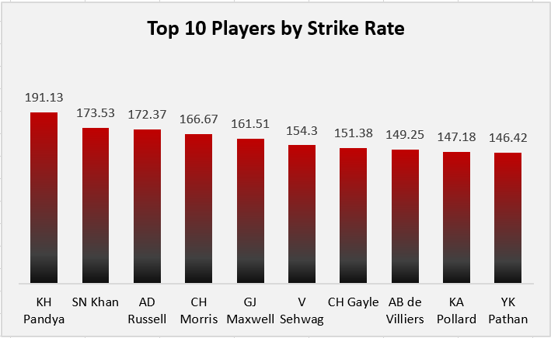
TOP STRIKE RATES
Strike Rate = (Runs Scored / Balls Faced) × 100
Analysis:
This query identifies the top 10 players with the highest strike rates across the seasons, considering players who faced at least 100 balls. KH Pandya leads with a strike rate of 191.13, followed by SN Khan (173.53) and AD Russell (172.37), highlighting their ability to score runs quickly.
Insight:
High-strike-rate players can help teams accelerate scoring, particularly during the middle and death overs. For RCB, these results can support player selection and auction decisions by identifying aggressive batting options, while considering consistency and overall contribution alongside strike rate.

Slide 11
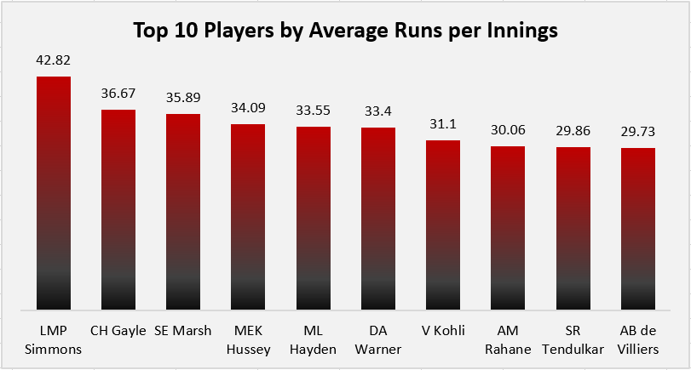
TOP PLAYERS BY AVERAGE RUNS PER INNINGS
Average Runs per Innings=
(Total Runs Scored/Total Innings Played)
Analysis:
LMP Simmons leads the chart with an average of 42.82 runs per innings, followed by CH Gayle (36.67) and SE Marsh (35.89). The top 10 players maintain averages ranging from 29.73 to 42.82 runs per innings.
Insight:
A higher average runs per innings indicates a player's ability to contribute consistently to the team's total. For RCB, this metric can help identify dependable batting options who can build innings and strengthen the batting lineup, alongside strike rate and other performance measures.

Slide 12
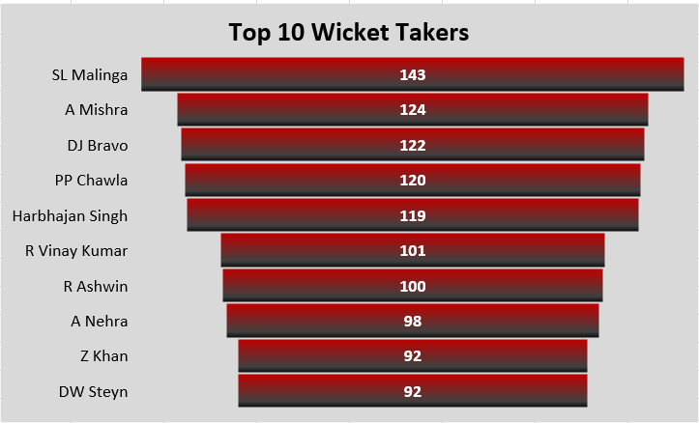
TOP WICKET TAKERS
Total Wickets=Count of Bowler-Credited Dismissals
Analysis:
SL Malinga leads the chart with 143 wickets, followed by A Mishra (124) and DJ Bravo (122). The top 10 bowlers have taken between 92 and 143 wickets, highlighting their substantial wicket-taking contributions across the IPL seasons analysed.
Insight:
Consistent wicket-taking is crucial for controlling opposition scoring and creating match-winning opportunities. For RCB, these results help identify proven wicket-taking bowlers who could strengthen the bowling attack, alongside consideration of economy rate, consistency, and current team requirements.

Slide 13
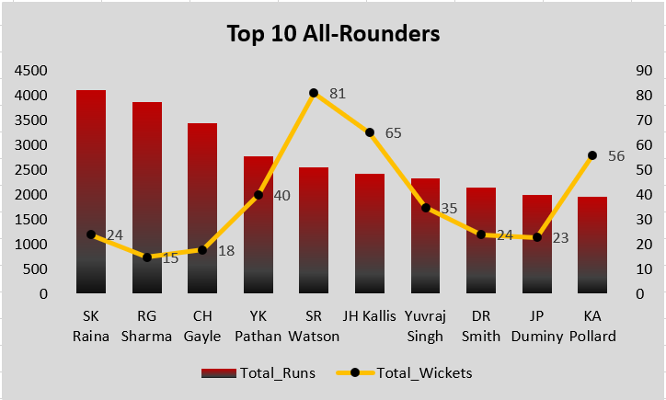
ALL-ROUNDER PERFORMANCE
Analysis:
SK Raina leads the chart with 4,106 runs, followed by RG Sharma (3,874) and CH Gayle (3,447). Among these players, SR Watson has the highest wicket count at 81, followed by JH Kallis (65) and KA Pollard (56).
Insight:
The comparison highlights different strengths among all-rounders, with some contributing more through batting and others through wicket-taking. For RCB, selecting players who can make meaningful contributions in both departments can improve squad balance and provide greater flexibility in team combinations.

Slide 14
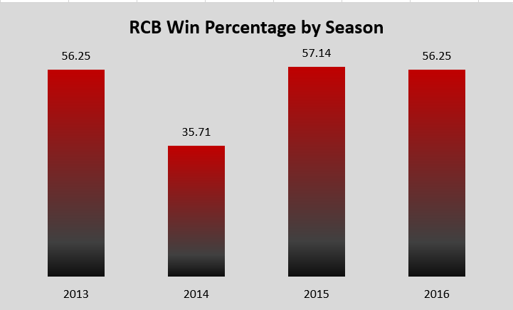
RCB WIN PERCENTAGE BY SEASON
Win Percentage = (Total Wins/Total Matches Played)*100
Analysis:
RCB recorded a win percentage of 56.25% in 2013, which dropped significantly to 35.71% in 2014. The team recovered to 57.14% in 2015 before finishing 2016 at 56.25%.
Insight:
The sharp decline in 2014 highlights inconsistency in RCB’s seasonal performance. Although the team recovered in 2015 and maintained a similar win rate in 2016, improving consistency across seasons should remain a priority.

Slide 15
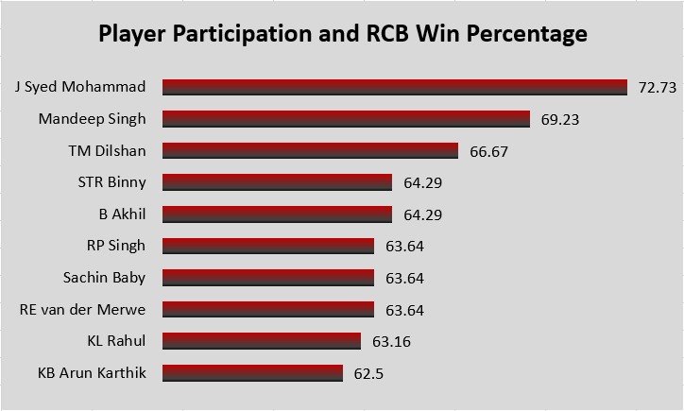
PLAYER PARTICIPATION & RCB WIN %
Analysis:
J Syed Mohammad ranks highest, with RCB winning 72.73% of matches in which he participated, followed by Mandeep Singh at 69.23% and TM Dilshan at 66.67%. The top 10 players shown have participation-based win percentages ranging from 62.50% to 72.73%.
Insight:
These results help identify players associated with stronger RCB match outcomes during their appearances. However, player selection should also consider the number of matches played, individual batting and bowling performance, and consistency rather than relying on win percentage alone.

Slide 16
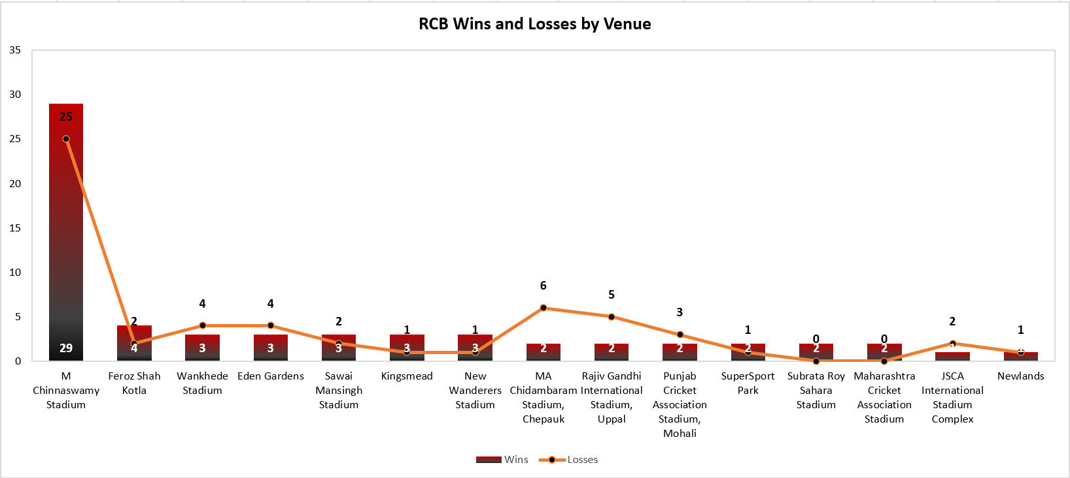
RCB WIN-LOSS PATTERN BY VENUE

Slide 17
Analysis:
M. Chinnaswamy Stadium recorded the highest number of RCB wins (29) as well as losses (25), making it the venue with the largest match volume in this chart. Feroz Shah Kotla recorded 4 wins and 2 losses, while Wankhede Stadium and Eden Gardens each recorded 3 wins and 4 losses.
Insight:
RCB’s results vary across venues, suggesting that performance has not been equally strong at every ground. The team should consider venue-specific performance when planning strategies and selecting players, while accounting for the number of matches played at each venue.

Slide 18
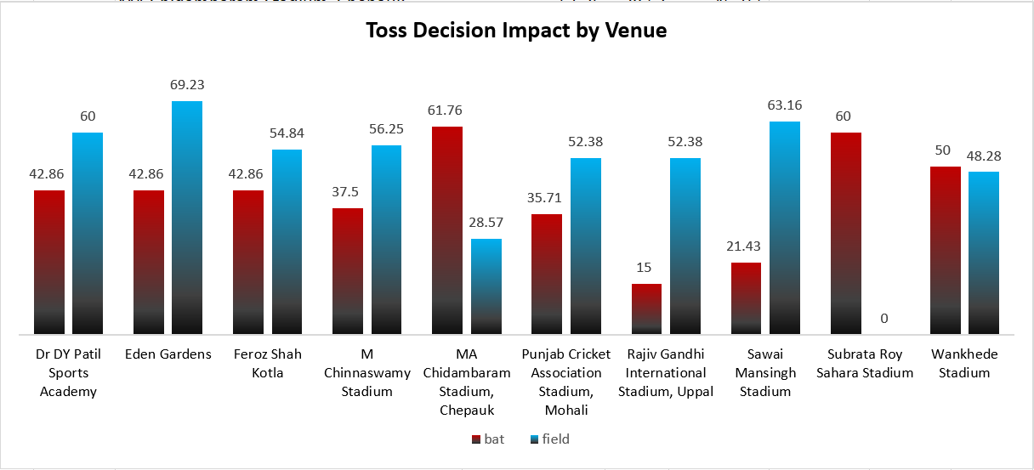
TOSS DECISION IMPACT BY VENUE

Slide 19
Analysis:
The analysis shows that the relationship between toss decisions and match outcomes varies across venues. At Eden Gardens, fielding first has a higher win percentage (69.23%) than batting first (42.86%). A similar pattern appears at Sawai Mansingh Stadium, where the win percentages are 63.16% for fielding first and 21.43% for batting first. However, at MA Chidambaram Stadium, batting first performs better, with a 61.76% win percentage compared with 28.57% for fielding first. Wankhede Stadium shows a much smaller difference, with 50% for batting first and 48.28% for fielding first.
Insights:
Venue-specific patterns: Fielding first has a higher observed win percentage at several venues, but the pattern is not consistent across all venues.
Exceptions matter: MA Chidambaram Stadium shows a clear reverse pattern, where batting first performs better.
Strategic implication: Teams should consider venue-specific historical results when deciding whether to bat or field after winning the toss.
Limitation: These percentages show an association, not proof that the toss decision determines the result. The number of matches and other match conditions should also be considered.

Slide 20
KEY FINDINGS
Batting Performance: KH Pandya recorded the highest strike rate at 191.13, while LMP Simmons led average runs per innings at 42.82.
Bowling Performance: SL Malinga topped the wicket-taker analysis with 143 wickets, followed by A Mishra (124) and DJ Bravo (122).
All-Rounders: SK Raina led the analysed all-rounder list in runs (4,106), while SR Watson led in wickets (81).
RCB Seasonal Trends: 2014 was RCB’s weakest season (35.71% win rate), while 2016 recorded the highest runs (2,859).
Toss Impact: Teams choosing to field first won 55.27% of matches, compared with 45.21% for teams choosing to bat first; results varied by venue.
Venue Performance: RCB won 29 of 54 matches at M Chinnaswamy Stadium, achieving a 53.70% win rate.
Player–Venue Insights: ST Jayasuriya recorded a strike rate of 226.88 at Wankhede Stadium, highlighting the value of venue-specific analysis.
Strategic Recommendation: Player selection should balance batting, bowling, consistency, and venue performance rather than rely on a single metric.

Slide 21
RECOMMENDATIONS
Strengthen the Bowling Attack: Prioritise consistent wicket-takers and evaluate bowling effectiveness alongside total wickets.
Select Balanced All-Rounders: Choose players who contribute meaningfully with both bat and ball.
Improve Batting Consistency: Consider strike rate, average runs per innings, and performance across multiple seasons.
Adopt Venue-Specific Strategies: Use historical venue scoring rates and player–venue performance to plan batting and bowling tactics.
Use Toss Data Strategically: Consider venue-specific toss trends while making decisions, rather than assuming batting or fielding first is always better.
Build a Balanced Squad: Combine dependable batters, effective bowlers, and versatile all-rounders to improve team balance.
Apply Data-Driven Selection: Evaluate multiple performance metrics together instead of relying only on reputation or one outstanding statistic.
Review Performance Regularly: Track seasonal win percentages, scoring trends, and bowling contributions to identify weaknesses and improve future strategies.

Slide 22
CONCLUSION
The analysis shows that IPL team performance depends on a combination of strong batting, effective bowling, consistent player contributions, and venue-specific strategies. RCB’s performance from 2013 to 2016 varied across seasons, with 2014 being its weakest season and 2016 recording the highest total runs. The results also show that toss decisions and player performance can vary across venues.
Overall, the findings highlight the importance of maintaining a balanced squad, selecting players based on multiple performance metrics, and adapting strategies to match conditions to achieve more consistent results.

Slide 23
THANK YOU

